Slide 1
Foreign Exchange Market

Slide 2
Learning Objectives
Explore the functions and structure of the foreign exchange market.
Describe the transactions conducted in the foreign exchange market.
Examine the forms of currency quotations.

Slide 3
Functions of the Foreign Exchange Market
The foreign exchange market is the mechanism by which participants:
transfer purchasing power between countries;
obtain or provide credit for international trade transactions;
minimize exposure to the risks of exchange rate changes.

Slide 4
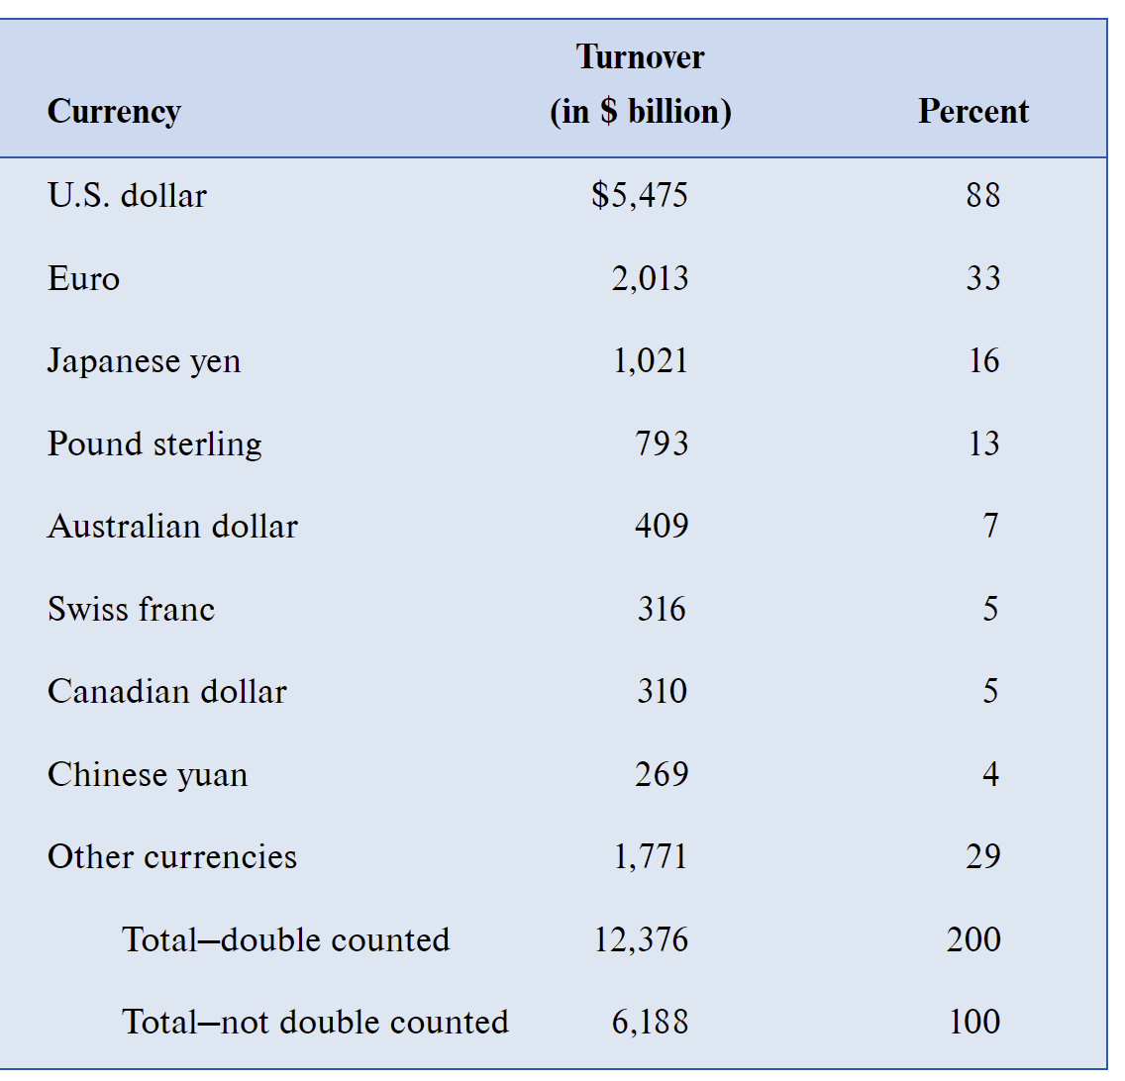
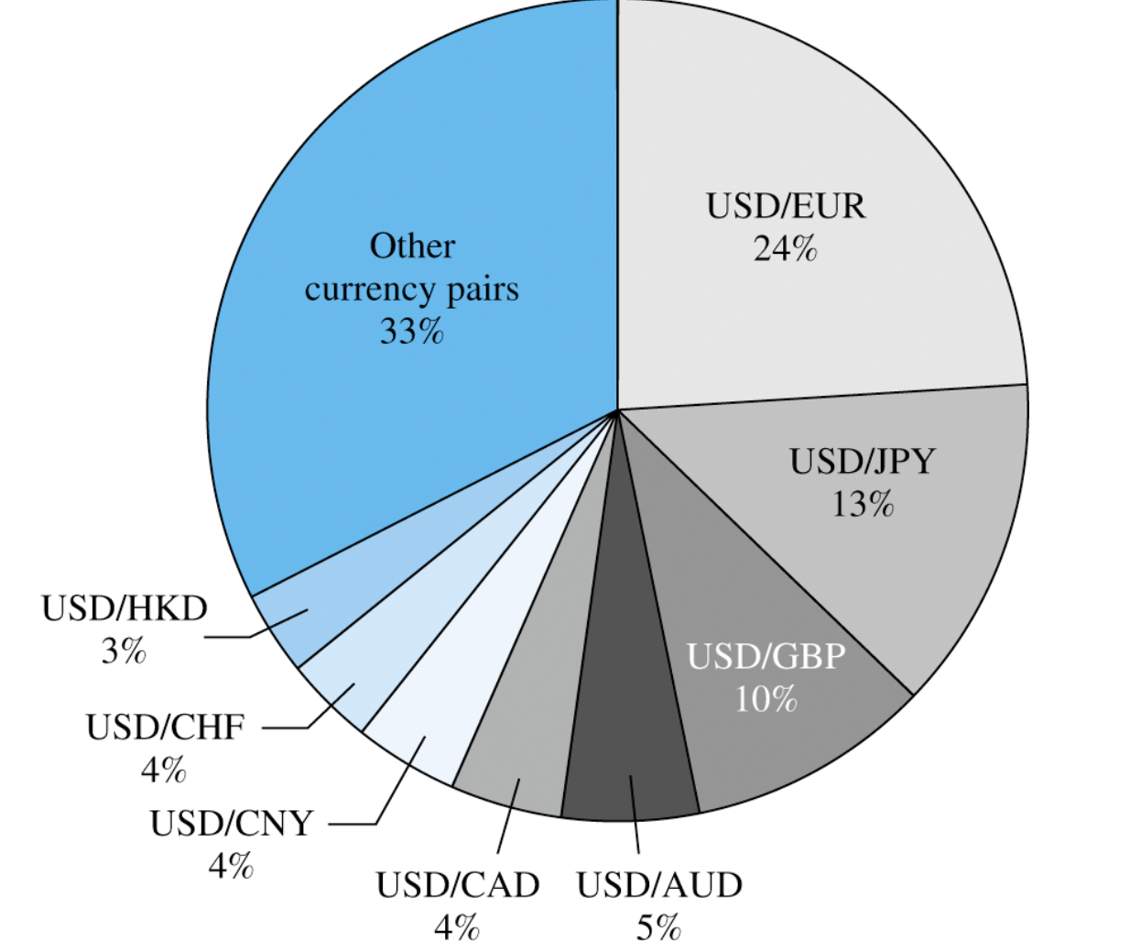
The foreign exchange market is the largest financial market in the world.
The daily trading volume is $6.19 trillion in 2019.
Source: Triennial Central Bank Survey, 2019

Slide 5
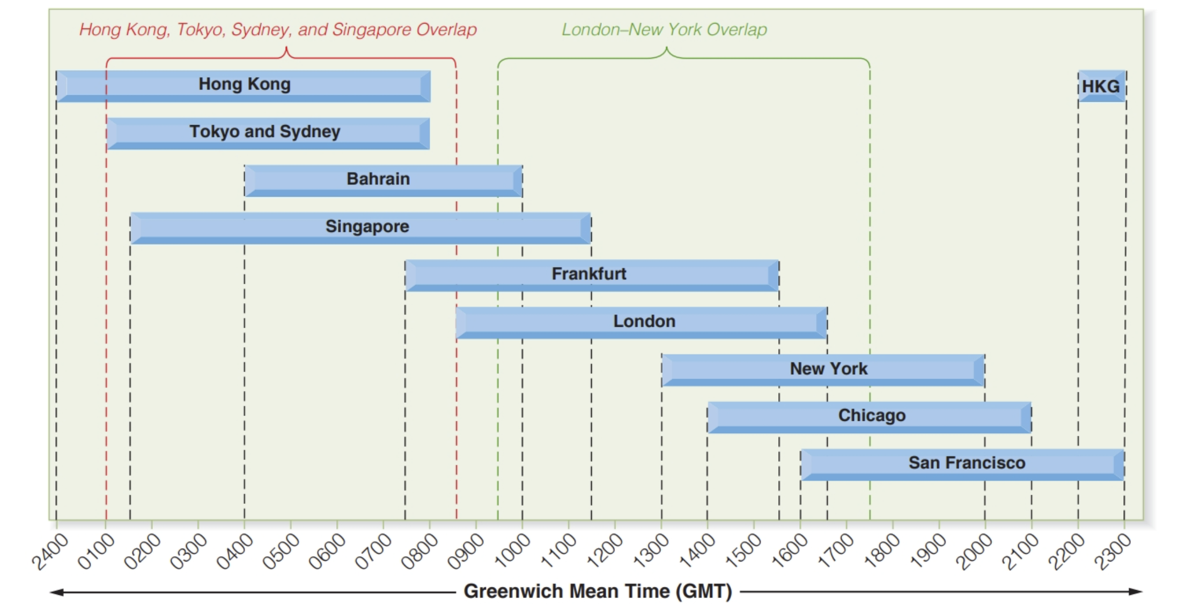
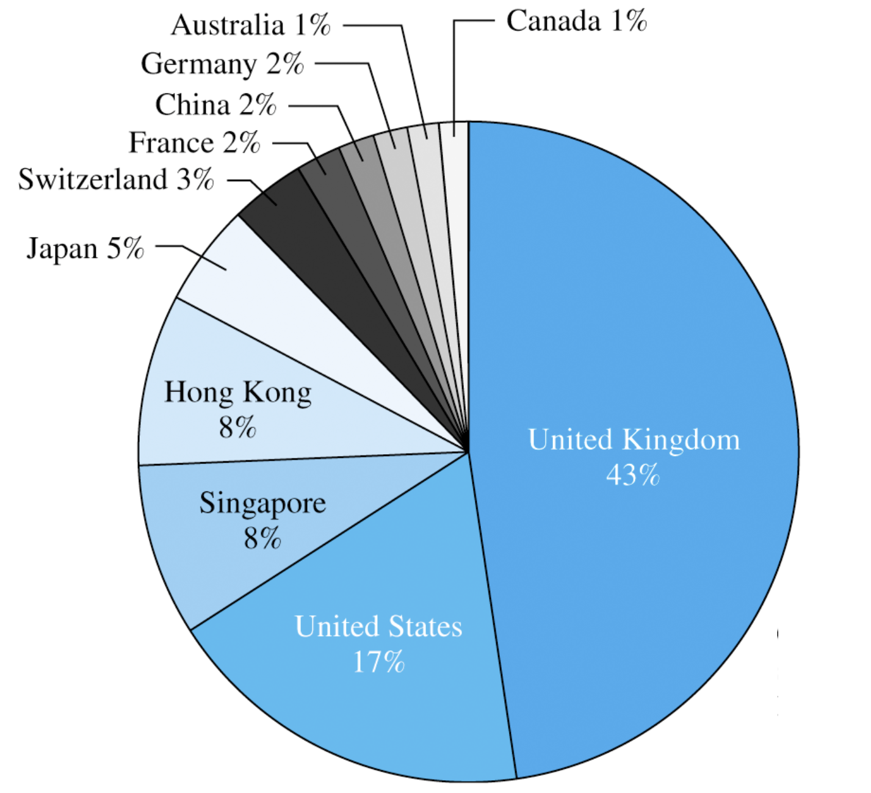
The currency trading day extends 24 hours of every business day.
Source: Triennial Central Bank Survey, 2019

Slide 6
Structure of the Foreign Exchange Market
The foreign exchange market is a worldwide linkage of various market participants via a network of telephones, computers, and automated dealing system.
Five broad categories of participants in the market:
Bank and nonbank foreign exchange dealers.
Commercial or investment transactors.
Speculators and arbitragers.
Central banks and treasuries.
Foreign exchange brokers.

Slide 7
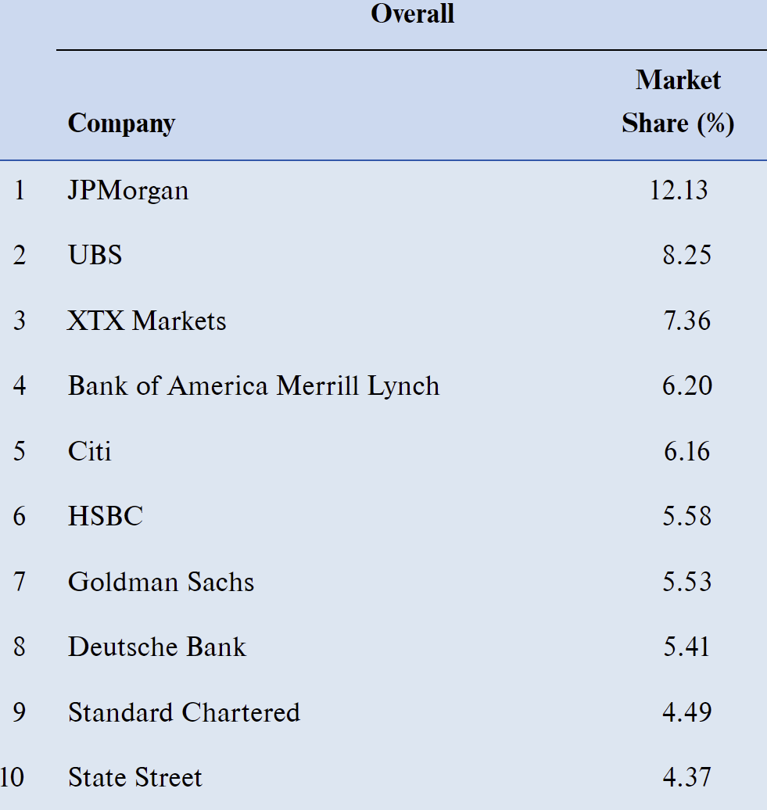
Bank and nonbank foreign exchange dealers.
Large international banks and large nonbank financial institutions (e.g. IB, MF, PF, and HF) function as market makers, that is they maintain an “inventory” of maintain an “inventory” of currencies currencies and stand willing to buy and sell for their own account.
They profit from buying foreign exchange at a bid price and reselling it at a slightly higher ask price.
Source: Euromoney, May 2019

Slide 8
Commercial or investment transactors.
Importers and exporters, international portfolio investors, multinational corporations, tourists, and others use the foreign exchange market to facilitate execution of commercial or investment transactions and hedge their foreign exchange risks.
Speculators and arbitragers.
Speculators seek their profit from correctly judging the direction of exchange rate movements.
Arbitragers try to profit from temporary price discrepancies in currencies between competing dealers.
Central banks and treasuries.
They conduct foreign exchange intervention by converting between foreign currency reserves and one’s own currency to influence the exchange rate.
Foreign exchange brokers.
They match dealer orders to buy and sell currencies for a fee, but do not take a position themselves.

Slide 9
Transactions in the Foreign Exchange Market
Transactions in the FX market are defined by the future date set for delivery. There are three major types of over-the-counter currency transactions.
spot transactions(32%).
forward transactions(16%).
swap transactions(52%).

Slide 10
Transactions in the Foreign Exchange Market (Cont.)
Spot transactions
A spot transaction is the purchase of foreign exchange with delivery and payment between banks taking place normally on the second following business day.
Forward transactions
A forward transaction requires delivery at a future settlement date of a specified amount of one currency for a specified amount of another currency.
The exchange rate is established at the time of the agreement, but payment and delivery are not required until maturity.
Forward exchange rates are usually quoted for settlement dates of one, two, three, six, and twelve months.
Swap
A swap transaction is the simultaneous purchase and sale of a given amount of foreign exchange for two different settlement dates.
Both purchase and sale are conducted with the same counterparty.
Some different types of swaps are:
Spot against forward: no unexpected FX risk
Forward-forward: borrowing one currency with lending another currency
Nondeliverable forwards (NDF): settle in US $, offshore, speculation

Slide 11
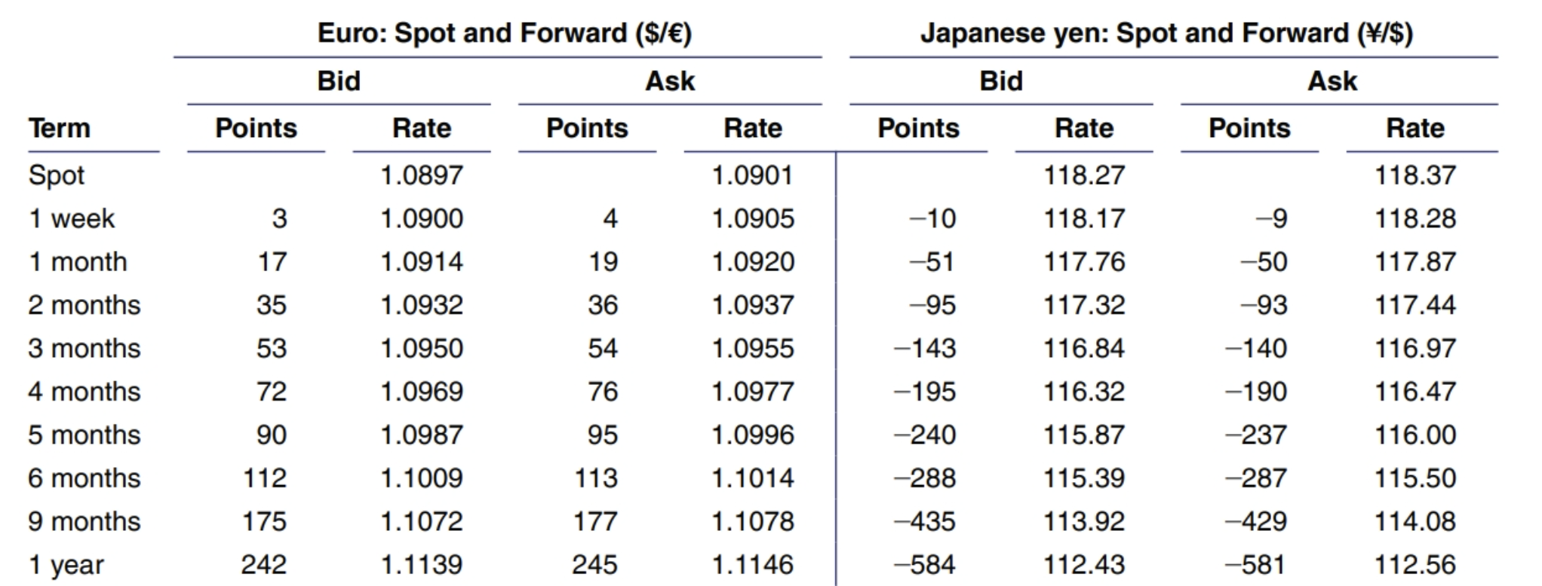
Foreign Exchange Rate Quotations
A foreign exchange rate is the price of one currency expressed in terms of another currency.
Spot rate: S(j/k) refers to the price of one unit of currency k in terms of currency j.
Forward rate: F_{N}(j/k) refers to the price of one unit of currency k in terms of currency j for delivery in N months.

Slide 12
Foreign Exchange Rate Quotations (Cont.)
Direct quotation is the home currency price of a unit of foreign currency.
From the U. S. perspective, a direct quotation is referred to as American terms, i.e. the price of one unit of the foreign currency in U.S. dollar .
Euro and British pound are conventionally quoted in American terms.
American terms are also used in quoting most foreign currency options and futures.
Indirect quotation is the foreign currency price of a unit of home currency.
From the U. S. perspective, an indirect quotation is referred to as European terms, i.e. the price of one U.S. dollar in the foreign currency.
It is commonly used to quote FX with U.S. dollar.
Direct and indirect quotes are reciprocals of each other.

Slide 13
Bid and Ask Rates
A bid is the price (i.e., exchange rate) in one currency at which a dealer will buy another currency.
An ask is the price (i.e., exchange rate) at which a dealer will sell the other currency.
The bid-ask spread is the difference between the bid and ask prices.
A bid for one currency is also the ask for the opposite currency.

Slide 14
Bid and Ask Rates Example-1
 | Bid | Ask
S($/£) | 1.5400 | 1.5405
S(£/$)
If customer wants to sell £1000 to dealer, how much $ will he get?
If customer wants to buy $1000 from dealer, how much £ will he need to pay?
If customer wants to sell $1000 to dealer, how much £ will he get?
If customer wants to buy £1000 from dealer, how much $ will he need to pay?

Slide 15
Bid and Ask Rates Example-2
A businessman has just completed transactions in Italy and England. He is now holding €250,000 and £500,000 and wants to convert to U.S. dollars.
His currency dealer provides this quotation:
GBP/USD: 0.6488 – 93
USD/EUR: 1.4739 – 44
What are his proceeds from conversion?

Slide 16
Cross-exchange Rates
Many currency pairs are only inactively traded, so their exchange rate is determined through their relationship to a widely traded third currency (cross rates).
Suppose that S(¥/$) = 101, and S(Ps/$) = 18, what must the S(¥/Ps) cross rate be?
Cross rates can be used to check on opportunities for intermarket arbitrage.
Triangular arbitrage.

Slide 17
Triangular Arbitrage Example-1
Citi Bank | USD1.3297 = 1 EUR
Barclays Bank | USD1.5585 = 1 GBP
Dresdner Bank | EUR1.1722 = 1 GBP
Is there any arbitrage opportunity?
If yes, how much profit can you make if you start with $1,000,000?

Slide 18
Triangular Arbitrage Example-2
Bank Quotations | Bid | Ask
$/£ | $1.5400 | $1.5405
$/€ | $1.3087 | $1.3092
€/£ | ? | ?
If the €/£ quote is 1.1764-70, is there any arbitrage opportunity? How are you going to take advantage of this quote?
If the €/£ quote is 1.1775-80, is there any arbitrage opportunity? How are you going to take advantage of this quote?
If the €/£ quote is 1.1758-60, is there any arbitrage opportunity? How are you going to take advantage of this quote?

Slide 19
Forward Cross Rates
Country/currency | in US$ | per US$
Euro | 1.3092 | .7638
1-mos forward | 1.3093 | .7638
3-mos forward | 1.3098 | .7635
6-mos forward | 1.3107 | .7630
UK pound | 1.5405 | .6491
1-mos forward | 1.5402 | .6493
3-mos forward | 1.5396 | .6495
6-mos forward | 1.5389 | .6498
What is the 3-month forward €/£ cross rate F₃(€/£)=?

Slide 20
Forward Premium or Discount
Spot | S($/£)= 1.5405 | S(£/$)= .6491
1-mos forward | F₁($/£)= 1.5402 | F₁(£/$)=.6493
3-mos forward | F₃($/£)= 1.5396 | F₃(£/$)=.6495
6-mos forward | F₆($/£=) 1.5389 | F₆(£/$)=.6498
Pound is trading at a discount versus the dollar.
Dollar is trading at a premium versus the pound.
Market participants expect the pound to depreciate against the dollar.

Slide 21
Forward Premium or Discount
The forward premium or discount of a forward rate is the annualized percentage deviation from spot rate.
The forward premium or discount for currency j over N period.
The forward premium or discount for U.S. dollar over N period.

